Slide 1
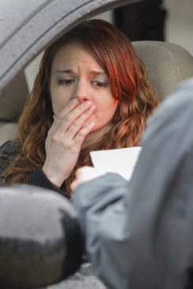



Session 6
Phase Two: Personal Contact

Slide 2

Learning Objectives
Identify typical clues of Detection Phase Two
Describe observed clues clearly and convincingly

Slide 3
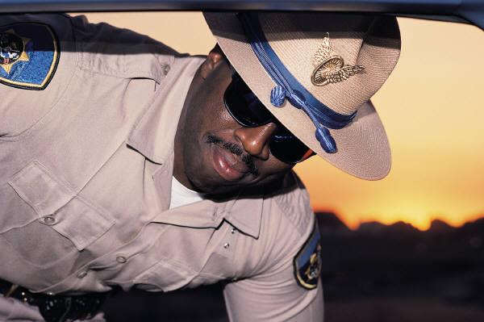
Phase Two: Personal Contact
Interview and
Observation
of the Driver
?

Slide 4
Phase Two: Personal Contact
Interview and
Observation
of the Driver
Should
Driver
Exit?
?
Observation of
the Exit

Slide 5
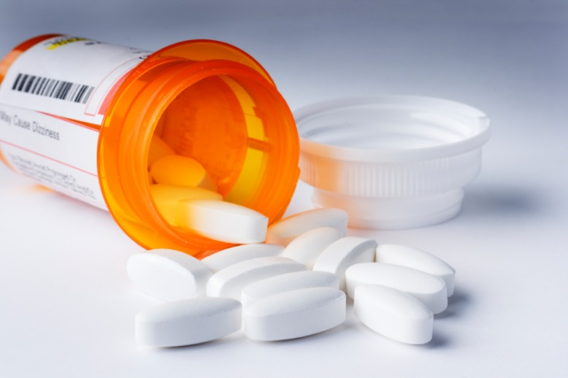
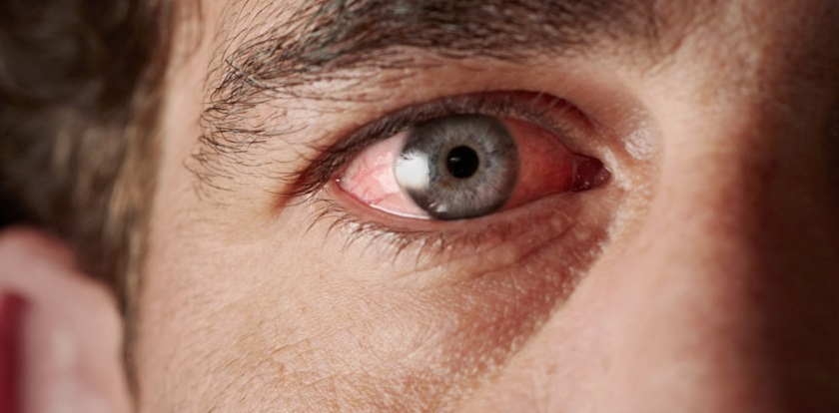
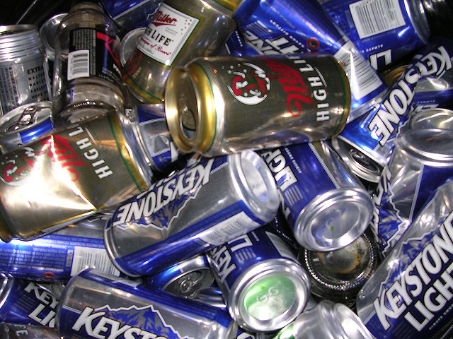
Personal Contact
What do you see?

Slide 6
What Do You See?
Bloodshot eyes
Soiled clothing
Fumbling fingers
Alcohol containers
Drug and drug paraphernalia
Bruises, bumps, scratches
Unusual actions

Slide 7
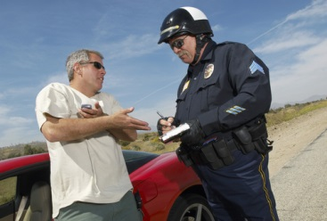
Personal Contact
What do you hear?

Slide 8
What Do You Hear?
Slurred speech
Admission of drinking
Inconsistent responses
Unusual statements
Abusive language
Anything else

Slide 9

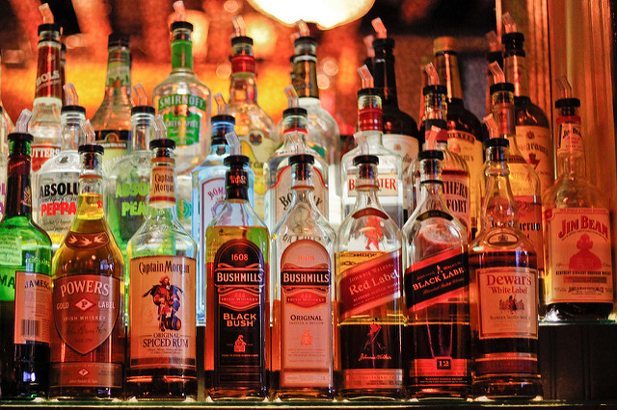
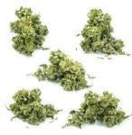
Personal Contact
What do you smell?

Slide 10
What Do You Smell?
Alcoholic beverage
Marijuana
“Cover-up” odors
Other unusual odors

Slide 11
Phase Two: Task One Face to Face Observation and Interview of Suspect
Requires the ability to:
Recognize the sensory evidence of alcohol and/or other drug influence
Describe that evidence clearly and convincingly

Slide 12

Procedures for Practicing Clue Recognition and Description

Slide 13
Testimony on The Busy Businessman
What was seen?
What was heard?

Slide 14
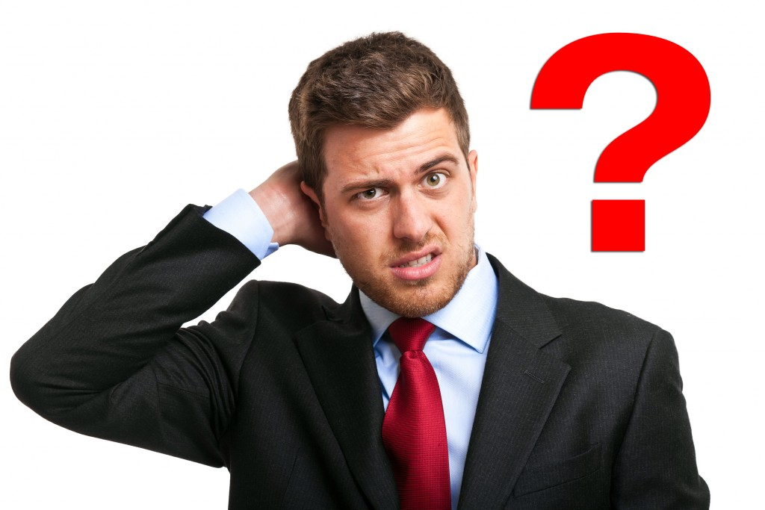
Interview/Questioning Techniques
Two things simultaneously
Interrupting or distracting questions
Unusual questions

Slide 15
License and Registration
Forgets to produce both documents
Produces wrong documents
Fails to see license, registration
Fumbles/drops item
Unable to retrieve documents using fingertips

Slide 16
Questions that Divide Attention
What day is it?
Where are you coming from?
Be alert for the driver who:
Ignores question
Forgets to resume search
Supplies grossly incorrect answer

Slide 17

Unusual Questions

Slide 18

Medical Questions
Physical conditions
Physician’s care
Medical issues
Medications

Slide 19

Additional Techniques Alphabet

Slide 20
Additional Techniques Count Down
68 67 66 65 64 63 62 61 60 59 58 57 56 55 54 53…

Slide 21
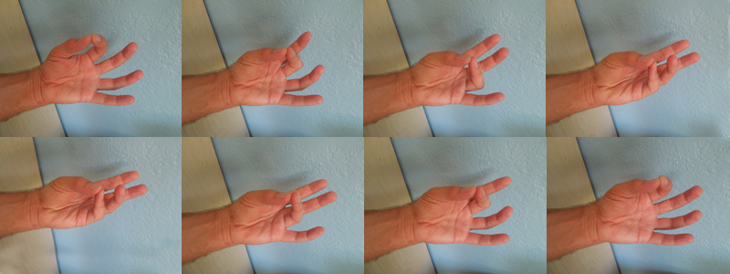
Additional Techniques Finger Count

Slide 22
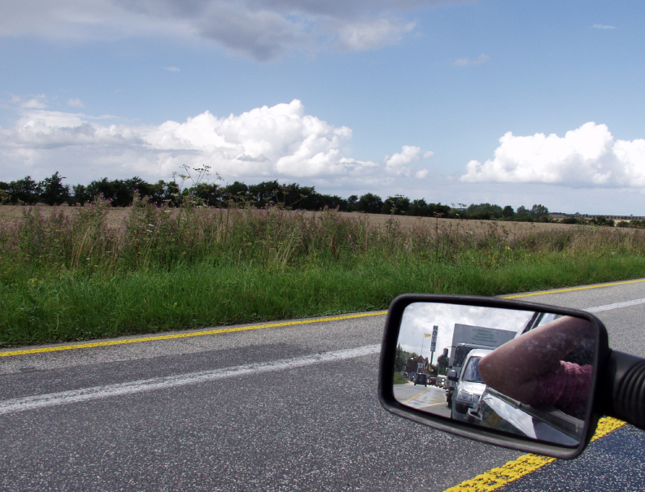
The Exit
What do you see?
Angry, unusual reaction
Can’t follow instructions
Can’t open door
Leaves car in gear
“Climbs” out of car
Leans against car
Keeps hand on car

Slide 23
The Exit

Slide 24
Questions?

Slide 25
Test Your Knowledge
The two major evidence gathering tasks of Phase Two are ____________________
The major decision of Phase Two is______
Among the describable clues an officer might see during the Phase Two interview are:
A.
B.
C.

Slide 26
Test Your Knowledge
Among the describable clues an officer might hear during the Phase Two interview are:
A.
B.
C.
Among the describable clues an officer might smell during the Phase Two interview are:
A.
B.

Slide 27
Test Your Knowledge
Three techniques an officer might use in asking questions that constitute simple divided attention tasks.
The Countdown Technique requires the subject to ___________________
Leaning against the vehicle is a clue to DWI which may be observed during ____________

